Slide 1
Buy American

Slide 2
Buy American=Country of Product or Service Origin and Place of Manufacture
The key to these two fields is vendor supplied answers in 52.225-2 Buy American Certificate, 52.225-6 Trade Agreements Certificate, or 52.212-3 if a Commercial Item Acquisition:
Country of Product or Service Origin:
If the product or service being procured is a domestic end product or service, enter “US.” If the product or service is not a domestic end product or service, enter the country code that designates the preponderance of the foreign content.
Place of Manufacture:
Identify if the end products will be manufactured inside or outside the U.S. If the end products will be manufactured outside the U.S., then……

Slide 3
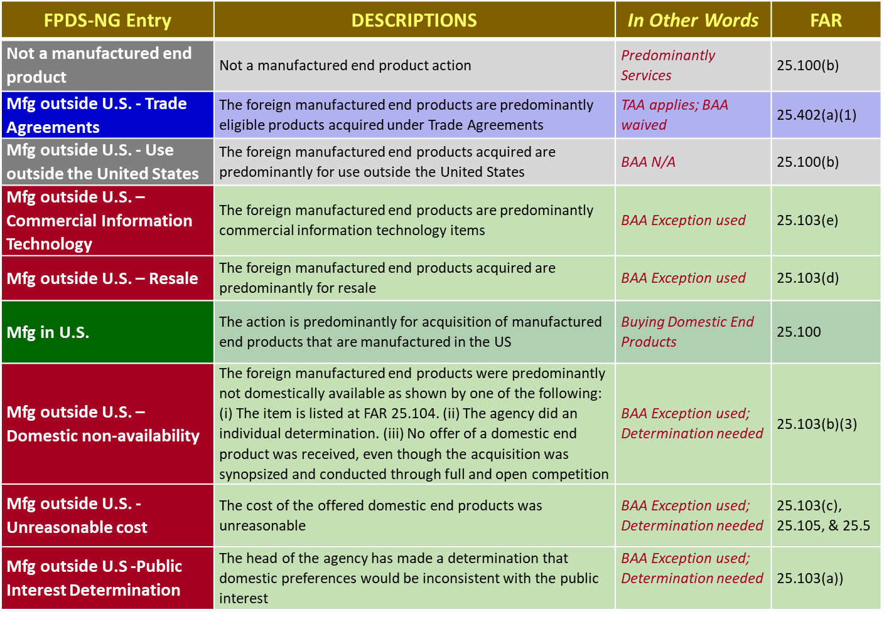
Buy American=Country of Product or Service Origin and Place of Manufacture
Look at 52.225-2, 52.225-6 or 52.212-3 and based on vendor responses select the FPDS Place of Manufacture code that best represents the exception to (see FAR 25.103) or reason to waive (see FAR 25.402) the Buy American Act.
START WITH GRAY, THEN GREEN, THEN BLUE, THEN RED
Requires Waiver

Slide 4
Buy American-Place of Manufacture
Remember:
Manufactured outside the US for use outside the US should only be selected when the supplies being purchased are actually for use outside the US.
Resale only applies to foreign end products specifically for commissary resale. It does NOT apply when supplies are being acquired from a reseller of an end item.
Public Interest requires approval by the Department Secretary\Agency Head and is rarely used.

